Slide 1




GLOBAL POWER PLATFORM BOOTCAMP
Organized Globally, Held Locally

Slide 2
Invoice Automation using PowerApps Power Automate and AI Builder
Nikhil Patel

Slide 3

I am a SharePoint developer. Focused on the PowerApps and Power Automate.
SharePoint | Office 365
Desire Infoweb
Member of SharePoint user Group Ahmedabad

Slide 4
Invoice Automation using PowerApps Power Automate and AI Builder
We are going to perform the Invoice Generation from the PowerApps and send it to the Company contact email.
After that we are also go through the Amazing AI Builder which will fetch all the Information from the uploaded document and provide us with a one click.
The main purpose of this session is to get rid of old school Invoice management process and use the latest process, and it can be implemented with worlds best No-code solution Application PowerApps.

Slide 5
Session Agenda
Introduction to Power Platform
Invoicing Process and Real life Challenges
Approach to Implement using Power Apps and Power Automate
Demo
Generate Invoice using PowerApps and Power Automate
Introduction to the AI builder in PowerApps
Use AI builder in PowerApps to track Incoming Invoice

Slide 6
Introduction to Power Platform

Slide 7
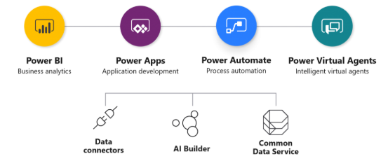

Slide 8

Power Platform New Member Power Virtual Agents
Power Virtual Agents empowers teams to easily create powerful bots using a guided, no-code graphical interface without the need for data scientists or developers.
Power Virtual Agents addresses many of the major issues with bot building in the industry today.
It eliminates the gap between the subject matter experts and the development teams building the bots, and the long latency between teams recognizing an issue and updating the bot to address it.
Empower your teams by allowing them to easily build bots themselves without needing intermediaries, or coding or AI expertise.
Reduce costs by easily automating common inquiries and freeing human agent time to deal with more complex issues.
Improve customer satisfaction by allowing customers to self-help and resolve issues quickly 24/7 using rich personalized bot conversations.

Slide 9
Invoicing Process and Real life Challenges

Slide 10

Invoice Process
An invoice, sometimes called a sales invoice or bill, is a document issued by a business to indicate a transaction, and to request payment for a product or service provided.
Invoices are an important part of any business. They help you get paid in a timely manner. Generally we generate Invoice and send them to the clients account team.
Challenges we have in Real life
Layout as per the Organization standards
Forget to send the Invoice on the Time
Missing or In correct data
Monitoring
Keep Track of Incoming Invoices
Approval Process for Invoices
Most Important one Time and efforts

Slide 11
Approach to Implement using Power Apps and Power Automate

Slide 12
To Generate Invoice
First we need to insert the Invoice data into the PowerApps and then we will save that data into the SharePoint list
After that Power Automate (aka Microsoft flow) will be triggered and create an Invoice as per the uploaded template and will send the Invoice to the companies contact persons in PDF format for further process.
Also it will save the Invoice with the metadata to the specified folder system in SharePoint, here we also can use One Drive or Drop box or the Google drive too.
For Incoming Invoice Process
We have finalize the process to generate the Invoice and send it to the client/company, What about the Incoming invoice in our organization.
To Resolve it we have life-saver and brand new Technology in PowerApps AI builder. Which automatically and intelligently fetch data from the updated PDF and after that we can perform the various operations as per our business process of the Organization.
Here for this demo, We are getting data from the AI builder and stores it into SharePoint list. Also we have the Approval system which will run an Approval for the Incoming Invoice process.
So, with this approach we can maintain the Invoice process by overcoming the Real life challenges.

Slide 13
Demo

Slide 14


Live Demo

Slide 15
Generate Invoice using PowerApps and Power Automate

Slide 16
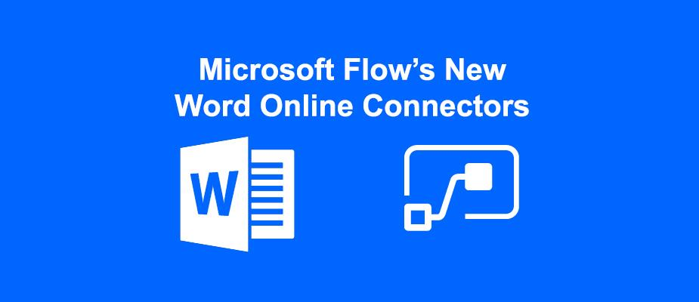
To Implement the Invoice automation we first we need to generate the word template for the Invoice.
Note: For that we need to enable the developer tab in word by these steps. Word → File → Options → Customize Ribbon → Developer. After that developer tab will be available.
That document will be uploaded into the One Drive.
We will use the Microsoft flow (aka Power Automate), to generate the Document and insert the data into the Pre defined Invoice template.
Flow will fetch all the details from the SharePoint list and enters into the Word Template using Populate a Microsoft Word template.
After generating the Template we will convert it to the PDF using Convert Word Document to PDF action.

Slide 17
Introduction to the AI builder in PowerApps

Slide 18
AI Builder is a new Power Platform capability that helps you improve business performance by automating processes and predicting outcomes.
AI Builder is a very handy and user friendly (for developers too) solution that brings the power of AI through a point-and-click experience. With AI Builder, you can add intelligence to your apps even if you have no coding or data science skills.
Important Note:
AI builder is not available for all the regions, Some features in AI Builder have not yet released for general availability (GA), and remain in preview status.
Preview features aren’t meant for production use and may have restricted functionality. These features are available before an official release so that customers can get early access and provide feedback.
We can use that by creating new environment in the Flow using the US region.

Slide 19
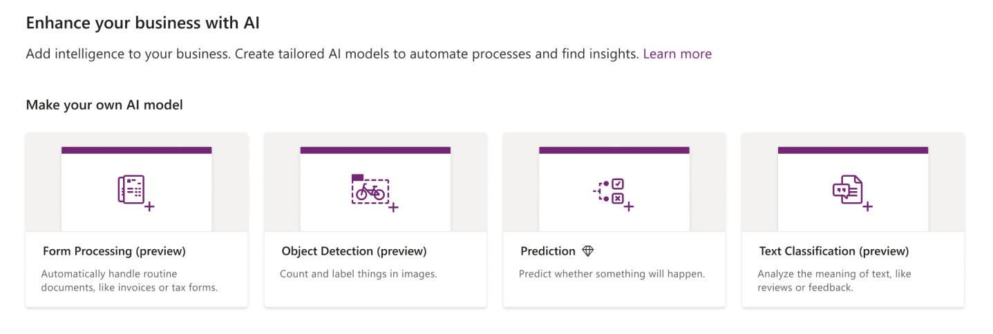
Currently we have four main Custom AI models
Prediction → Will predict the data based on the historical data
Form processing → Fetch the data from the Uploaded PDF
Object detection → Automatically detects the Objects
Text classification → Its more a Language processor which identifies text entries with Tags.

Slide 20
Use AI builder in PowerApps to track Incoming Invoice

Slide 21
These below are the main tasks which we need to perform in order to Implement the AI builder form processing in PowerApps
Create an AI Model for Form processing
Add Documents to Model
Once we have uploaded the 5 documents the analyze button will be enabled. The analyzing of the document can take a while.
After uploading we need to Identify the data from Document
Select Fields in AI Builder
We can now select the fields and AI builder will suggest field names too. We just have to click the ones that we are interested in.
Train the model
When we hit the train button quite quickly we’ll get the Training complete message.
On the details page we can publish model and now it can be used within Flow or PowerApps.
Use the Model in PowerApps

Slide 22
These below are the main tasks which we need to perform in order to Implement the AI builder form processing in PowerApps
Create an AI Model for Form processing
Add Documents to Model
Once we have uploaded the 5 documents the analyze button will be enabled. The analyzing of the document can take a while.
After uploading we need to Identify the data from Document
Select Fields in AI Builder
We can now select the fields and AI builder will suggest field names too. We just have to click the ones that we are interested in.
Train the model
When we hit the train button quite quickly we’ll get the Training complete message.
On the details page we can publish model and now it can be used within Flow or PowerApps.
Use the Model in PowerApps
Note: that we must need at least 5 documents before we can go over to the next step. If you thought that you could just rename the same document 5 times then you are wrong. AI build looks at the content of the files not just the name of the files!

Slide 23
Any Questions?

Slide 24

Please fill out the survey! & Win Swags!!
https://www.powerplatformbootcamp.com/survey

Slide 25
Thank You For Attending

